Slide 1

December 14, 2025

Slide 2
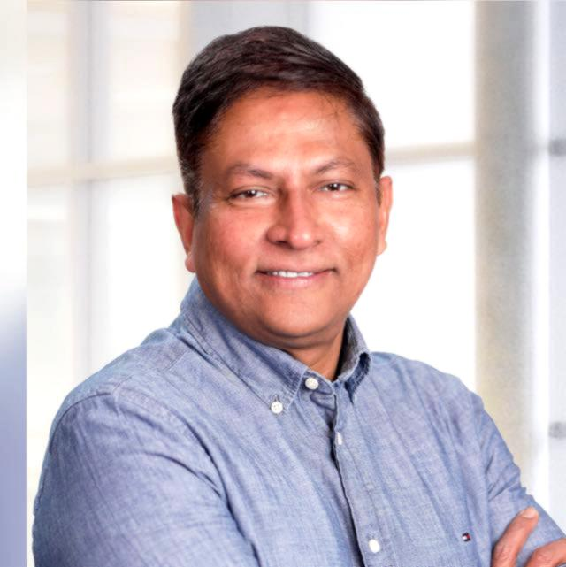
President 2026:
Raju Alluri
Vice President, Investments at Wedbush Securities Inc., specializing in tailored wealth management strategies for high-net-worth families. Previously held senior leadership roles at Valvoline and Merrill Lynch, with global experience spanning Asia and the United States.
A committed supporter of BIACS since 2010, passionate about community service and youth development.
Holds an MBA from Andhra University and has completed Senior Management Programs at IIM Ahmedabad and IIM Bangalore.

Slide 3
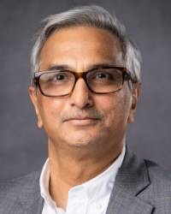
Past President 2026:
Naveen Gupta
Naveen Gupta, based out of Lexington, KY is Vice President – Digital Transformation at Valvoline Global.
A Certified Public Accountant from India, he is widely traveled and has held various senior roles in general management, finance and consulting in different parts of the world.

Slide 4
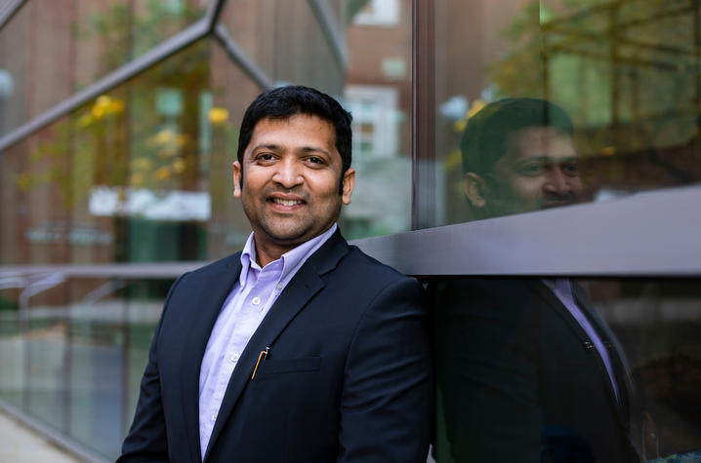
President Elect 2026:
Dr. Zain Guduru
Dr. Zain Guduru is an academic neurologist specializing in movement disorders. He serves as the Program Director for the Adult Neurology Residency at the University of Kentucky.
He is the current President of the Commonwealth Neurological Society and a Board Member of the Association of Indian Neurologists in America.
Dr. Guduru elected to American Society of Neuroimaging as a Board of Director for 2026-28
Beyond his professional accomplishments, Dr. Guduru is deeply committed to community engagement, service, and leadership that uplifts others.

Slide 5
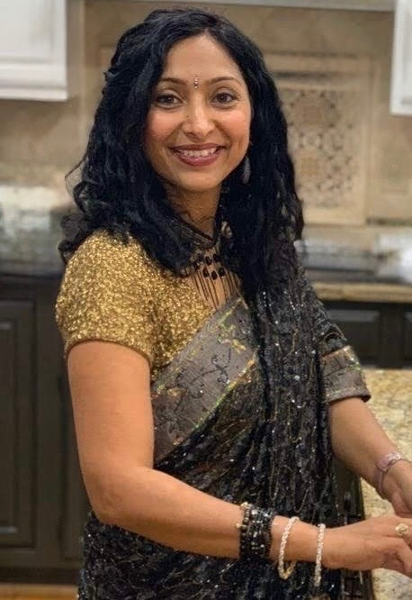
Secretary 2026:
Trisha Dang
Trisha Dang has been a resident of Lexington since 2011.
She is a Registered Clinical Respiratory Therapist and Certified Asthma Educator. From 2013 to 2018, Trisha worked at Kentucky Children’s Hospital, gaining valuable experience in pediatric respiratory care.
In 2016, Trisha transitioned into academia and has since served as a faculty member in the Respiratory Care Program at Bluegrass Community & Technical College (BCTC). As of August 2023, she also took on the role of Program Coordinator for both the Respiratory Care and CPR/BLS programs at BCTC.
Trisha is a Certified Yoga Instructor.
She is also a volunteer table host for the Parent Café program, organized by the Counseling Department at Rosa Parks Elementary School.
In her leisure time, Trisha enjoys long runs, reading, and spending quality time, making memories with her children.

Slide 6
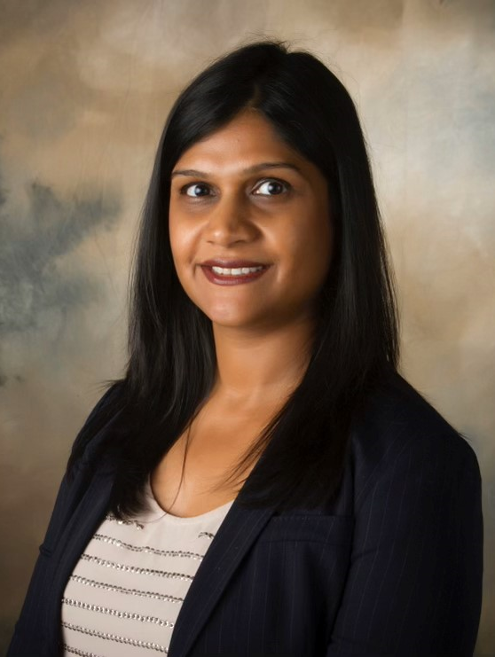
Treasurer 2026:
Tripti Kedia
Tripti Kedia has over 15 years of experience in Finance, Tax and Accounting across 3 continents.
She has a Masters in Finance from University of Kentucky and is a KY licensed CPA.
She and her family moved to Lexington in 2013 and has been a supporter of BIACS ever since.
She loves to travel, read, cook and spend time with her family and friends in her free time.
She believes firmly in the right to free and fair education for all children.

Slide 7
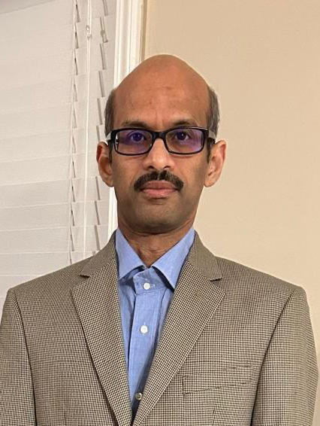
Counselor 2026:
Raja Ravipati
Raja Ravipati is a Sr. software engineer at Lexmark and has been a resident of Lexington for the past 25 years.
He has graduated from University of Toledo with a Master’s in Chemical Engineering.
He has served as a BIACS counselor in 2018.
He loves to volunteer and has participated in several Habitat for Humanity builds.

Slide 8
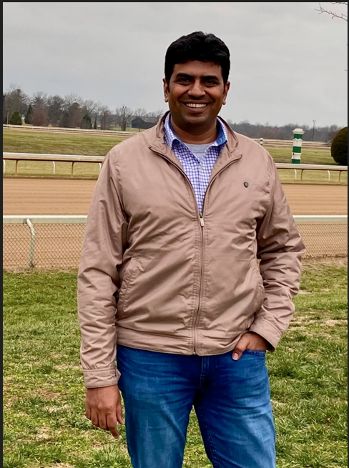
Counselor 2026:
Praveen Kumar Sivakumar
Dr. Praveen Kumar Sivakumar earned his Ph.D. in Electrical Engineering from the University of Kentucky and has worked in electronics manufacturing for 15+ years in USA and Canada.
He led operations across multiple sites at Conduent overseeing budgets, technology, processes, and workforce management.
He moved to Lexington in 2000 and lives with his wife, three daughters, and dog. In his spare time, he enjoys reading, and following basketball and cricket.
He is passionate about ensuring educational opportunities for all.

Slide 9
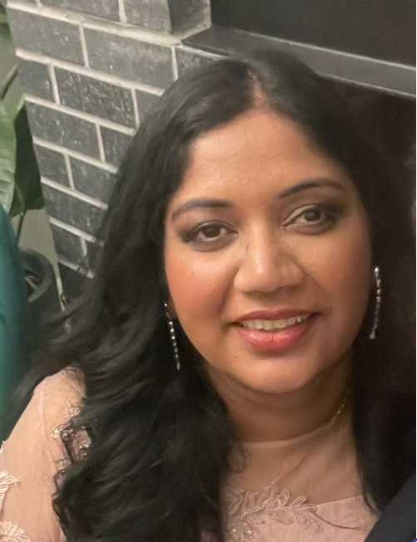
Counselor 2026:
Dr. Deepshikha Gupta
Deepshikha works as a Project Manager in a pharmaceutical company and has been a resident of Lexington from past 17 years.
She obtained PhD in Chemistry from University of Kentucky. She loves to travel, read and spend time with her family and friends during her free time.
She is passionate about giving back to society and has been volunteering with lot of local organizations.

Slide 10
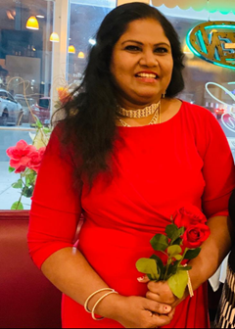
Fundraising Chair 2026:
Shobana Venkatesan
Shobana Venkatesan moved to Lexington, KY from Ottawa, Canada, in 2011. She holds a Masters and an M. Phil degree in Life Sciences.
She started her professional career as a Professor of Biochemistry at K. K. College of Pharmacy in Chennai TN India.
Later, she was a Product Executive at Sresan Pharmaceuticals, Chennai & Bangalore, India.
After emigrating to Canada, she worked at Statistics Canada in Gatineau, ON. From 2014, she started volunteering for Biacs, and from 2015 -2018 she served as a Counselor in BIACS.
She has also been a Fundraising chairman from 2019 to present.
She also volunteers as dance choreographer for the BIACS and BTCC cultural events. She is presently working as a Scientist in CHFS, Department of Public Health Lab Services, Frankfort, KY.

Slide 11
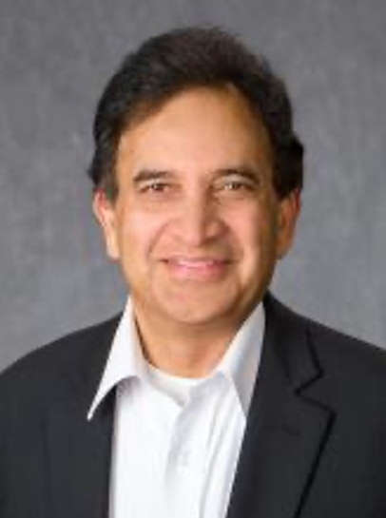
Scholarship Committee Chair
Dr. Subba Reddy Palli
University of Kentucky scientist and Kentucky State Entomologist, internationally recognized for pioneering RNA interference (RNAi) technologies to control insect pests and combat insecticide resistance
Professor & Chair, Department of Entomology; Interim Chair, Plant Pathology; Director, UK One Health Center
Named Fellow of the National Academy of Inventors (NAI) — the highest distinction for academic inventors in the U.S.
Inventor of 28 U.S. patents; authored 284 peer-reviewed publications and 4 books
Research spans insect molecular biology, genomics, toxicology, and disease-vector control, advancing safer and more effective pest-management solutions
Former President and Treasurer of BIACS.

