Slide 1
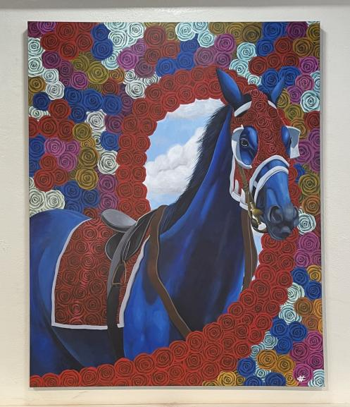
Priestly
48” x 60”
Acrylic on Canvas
$14,000

Slide 2
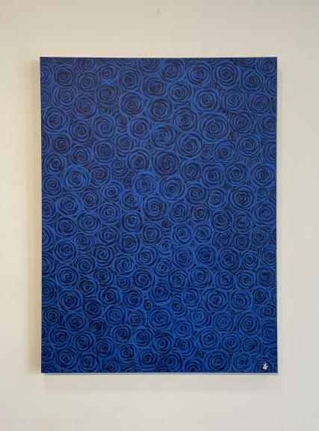
Cerulean
36” x 48”
Acrylic on Canvas
$5,500

Slide 3
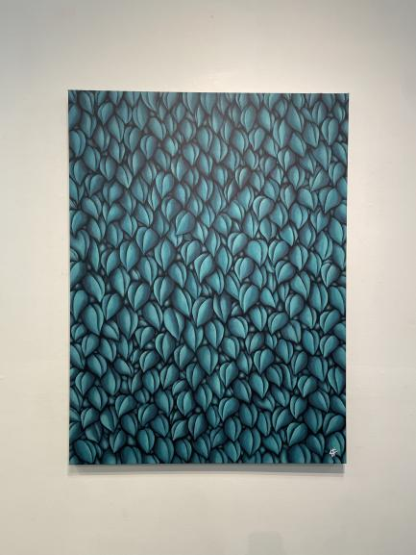
Blue Green
36” x 48”
Acrylic on Canvas
$4,500

Slide 4
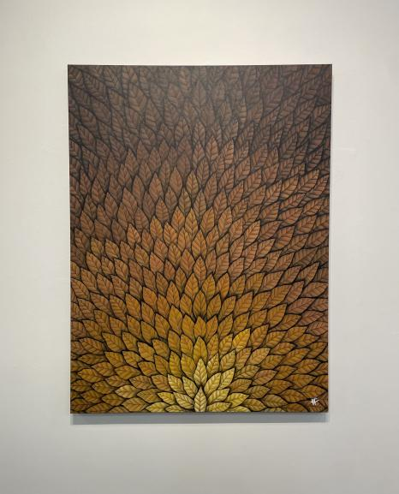
Yellow
36” x 48”
Acrylic on Canvas
$4,500

Slide 5
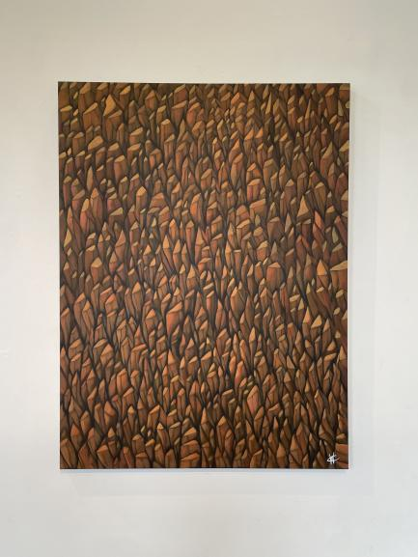
Orange
36” x 48”
Acrylic on Canvas
$4,500

Slide 6
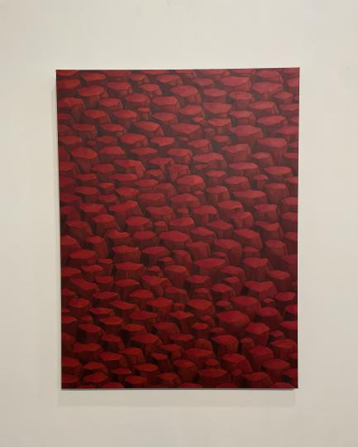
Red
36” x 48”
Acrylic on Canvas
$3,500

Slide 7
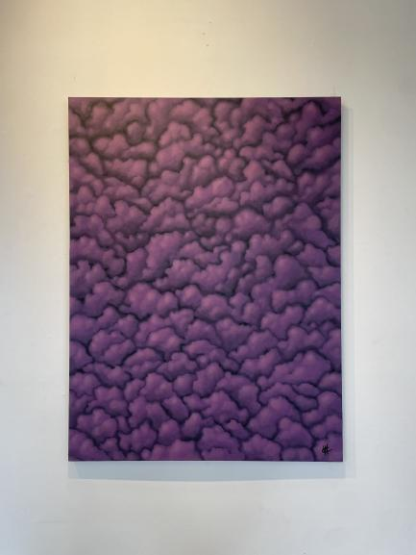
Purple
36” x 48”
Acrylic on Canvas
$3,500

Slide 8
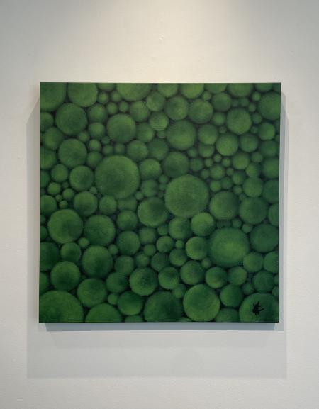
Green
24” x 24”
Acrylic on Canvas
$1,500

Slide 9
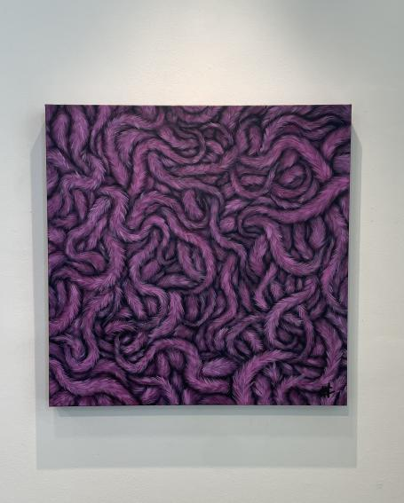
Pink
24” x 24”
Acrylic on Canvas
$1,500

Slide 10
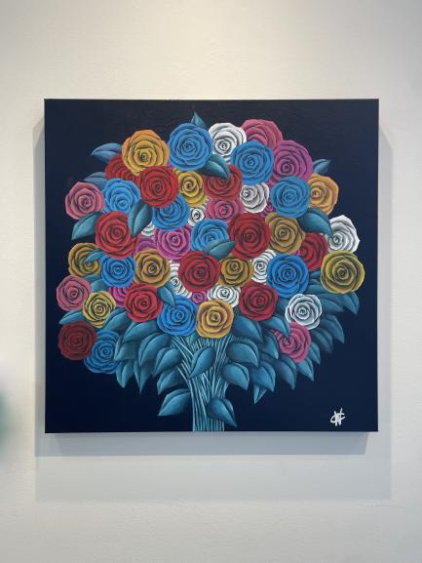
Patterns in Bloom
24” x 24”
Acrylic on Canvas
$2,500

Slide 11
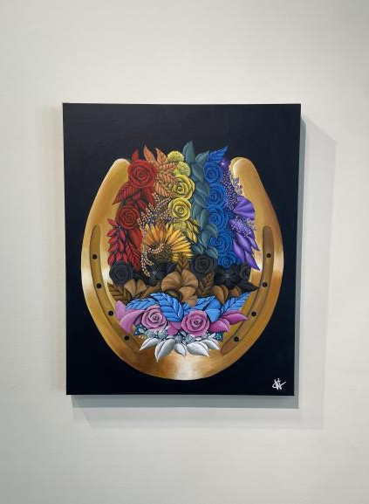
Lexington Pride
24” x 30”
Acrylic on Canvas
$4,500

Slide 12
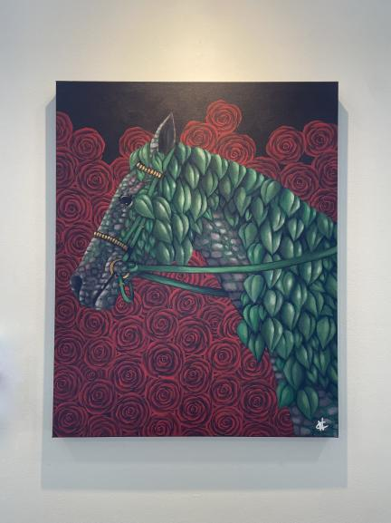
Limestone
24” x 30”
Acrylic on Canvas
$3,500

Slide 13
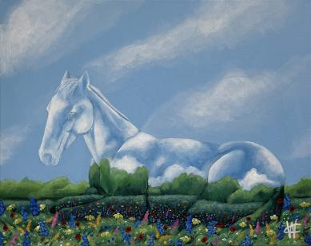
Creekside Farms
16” x 20”
Acrylic on Canvas
$1,000

Slide 14
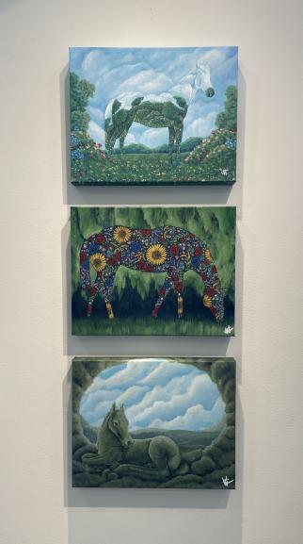
Mural Concept 1
Mural Concept 2
Mural Concept 3
16” x 20”
Acrylic on Canvas
$1,000 each

